Slide 1
HTTP-SERVER C app
Marculescu Tudor, ADVANCED COMPUTING IN EMBEDDED SYS
OPERATING SYSTEMS PROJECT

Slide 2
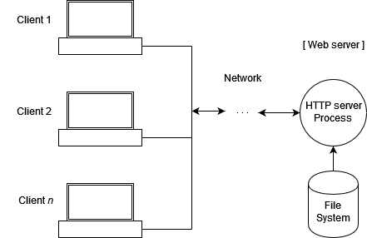
What is this project about?
A C application that runs on Linux
Serves a webpage to the user
Accessible via any port
Uses Sockets and Linux Api functions

Slide 3

Motivation & why is it useful
Apache webserver has a huge codebase
Can't see the forest from the trees
Improve my understanding of HTTP protocol
Show that the backbone of Apache is actually a simple program

Slide 4

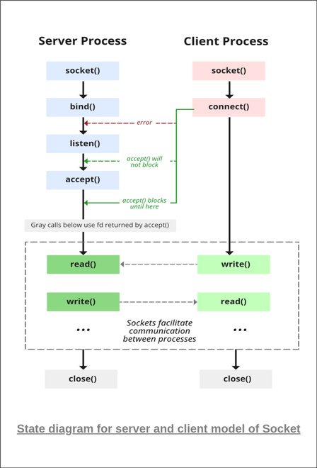

What is a net socket?
A way of receiving data between processes on the same machine or diff machines via a network
Can use TCP or UDP
Defined in socket.h header in UNIX-like systems

Slide 5
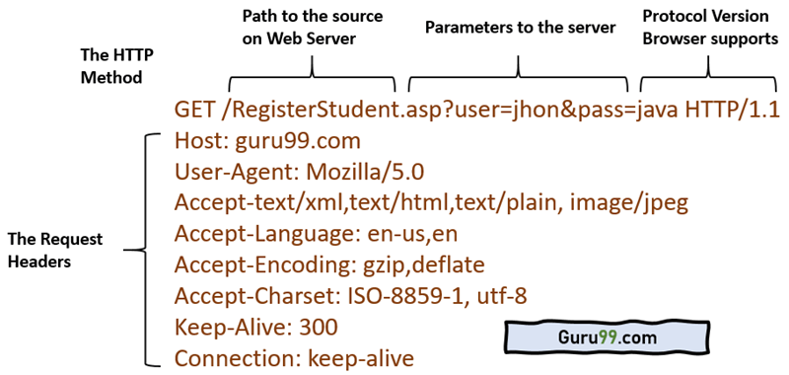
How does it serve exactly?
GET is used by the client to request a certain file
If it is empty, then it reply with index.html
Use send() to transmit the data via the socket
Free the memory – dynamic allocation

Slide 6
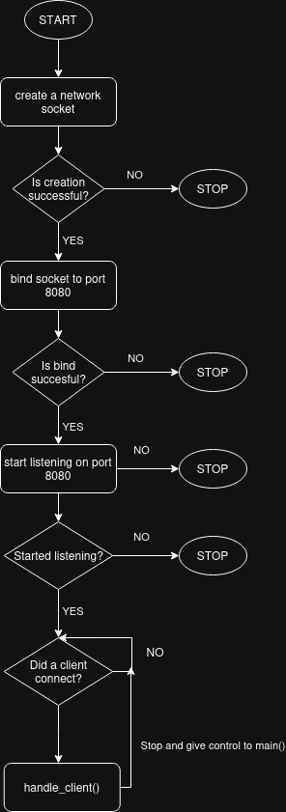
main() code flow

Slide 7
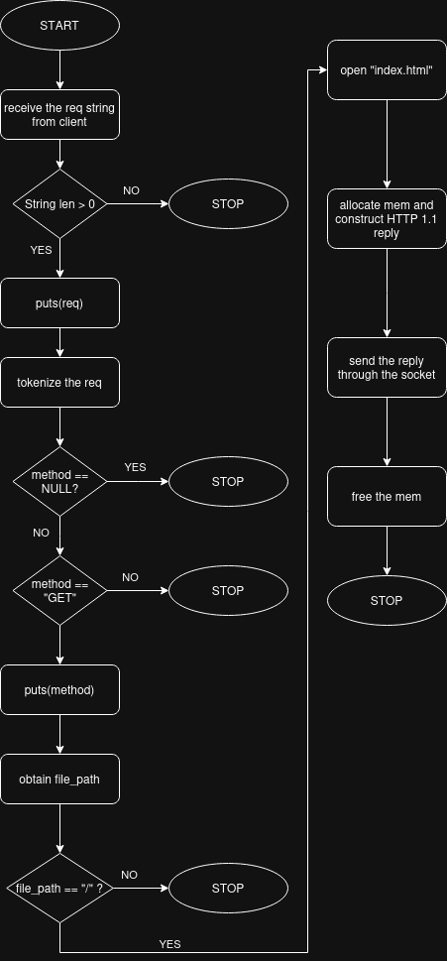
handle_client() code flow

Slide 8

DEMO run of the HTTP-Webserver
Present the build system
Present the source and headers
Present the main function
Build the proj & run it
Open firefox and show the index.html file

Slide 9


Comparison http-server VS apache2

Slide 10


Memory usage profiling - same index.html
heaptrack – http-webserver max usage 2.2MB RAM for 1 client
ps – apache2 max usage ~16 MB of RAM for 0 client
ps – apache2 max usage ~16.1 MB of RAM for 1 client

Slide 11
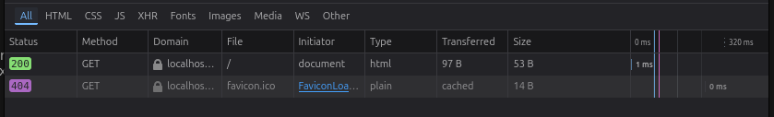
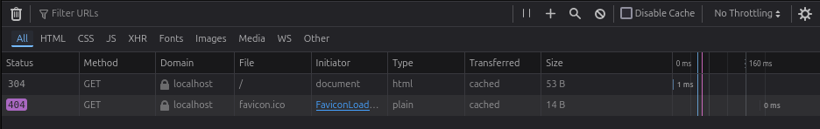
HTTP Reply speed profiling - same index.html
Firefox network tools – http-server 1ms response
Firefox network tools – apache2 1ms response

Slide 12
Optimizations & Personal contribution
Make use of dynamic allocation in HEAP
Remove the unnecessary features – very low mem usage
Contributions:
main() function
handle_client() function
Debugging with GDB and Valgrind
Build system
Presentation

Slide 13
Points to improve
Add more HTTP methods (POST, DELETE etc.)
Add HTTPS functionality
Include more MIME types

Slide 14
Thank you

